Slide 1
Narrative Paragraph Writing
English 102

Slide 2
A narrative paragraph describes an event, feeling or experience in story form or in the order the details of the event happened.
-The topic sentence introduces a significant, specific event and a controlling idea.
-The body tells a story in chronological order.
-The concluding sentence echoes the topic sentence.
-The purpose of a narrative is to inform, entertain, make a specific point, or evoke a certain emotional response from the reader.

Slide 3
Narrative paragraphs are often used to describe what a person does over a period of time.
A narrative paragraph tells a story. Usually, you write a narrative to share an important event. The details in the paragraph should answer the 5 WH questions: who? what? when? where? why? and how?

Slide 4
using past tense
Time transitions
Using first person (I) or third person (He/She)
Can never be used 2nd person
Using dialogue
Has a plot(main idea)
Single setting
Few characters
Creating a problem and giving resolution

Slide 5
Your Story Beginning
Your story needs a strong beginning. You can achieve this using one of the following methods:
Dialogue (Conversation)
A Question
A Vivid Description
An Interesting Fact
Sound Effects
http://www.learnnc.org/lp/pages/2992

Slide 6

Dialogue
“ Hurry or you’ll be late!” called my mother from the bottom of the stairs. “Today of all days you want to be on time.” If I had only know what that day would bring, I would have stayed in bed.

Slide 7
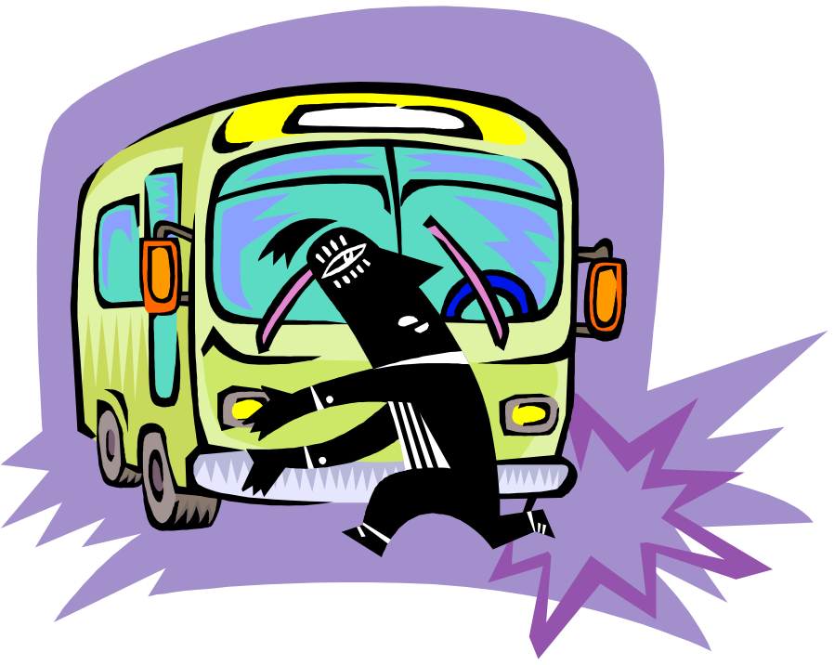
A Question
Have you ever had a day when you wished you had stayed in bed? As I rushed to catch the bus on what seemed to be a perfectly normal day I had no idea what was ahead of me.

Slide 8
A Vivid Description
The sun was warm on my back as I raced toward the waiting yellow school bus. As I nestled into the worn leather seat I was greeted by the friendly voices of other excited children. The look on my face was one of confidence and contentment. With a jerk the bus rumbled down the road and I was on my way into one of the worst days of my life.

Slide 9

An Interesting Fact
Shock has been known to kill ten year olds. It can cause their brains to explode and their heart to stop dead still. These facts raced through my mind as I stood dumbfounded in front of my fifth grade classmates. I wish I had stayed in bed!

Slide 10

Sound Effects
“Buzzzzzz!” The sound of my alarm clock droned in my ears as I struggled to come awake. With a start I sat straight up in my bed. This was my big day and I had to be on time.

Slide 11
The structure of a narrative paragraph:
Developing the topic sentence
Identifying specific topic e.g. use one setting and one event that occurs in a relatively short time frame.
Make sure the topic sentence provides a glimpse or a hint about the significance of the event or the emotion you experienced.
Revise the topic sentence to attract the reader’s interest.

Slide 12
Developing the body of the paragraph
Eliminate details that are insignificant to the telling of the story.
Do not mix first person( I or WE) and third person ( he, she or they)
Create coherence
Use transition words and conjunctions that show time and create coherence.
Use simple past tense to show that the event or the story has already taken place
Use descriptive words to create a strong visual for the reader
Select words that are consistent with the emotion or the mood of the paragraph
Include adequate development in your paragraph be selecting sufficient details to develop the story.

Slide 13
Developing the concluding sentence
Write a concluding sentence that echoes the topic sentence.
Use the same emotion and sense of significance that you stated in the controlling idea and expressed throughout the paragraph.
Check your concluding sentence.

Slide 14
A sample narrative paragraph
My Most Embarrassing Moment
Topic Sentence:
The most embarrassing moment of my sophomore year was how I earned my nick name, Crash.

Slide 15
Supporting sentences
It all started right after school when I turned on to the busiest street by the school. First I pulled up right behind this truck at a stop sign. After a second, a fellow older student told me that I was really close and that I was going to hit the truck in front of me. At the moment I was trying to tell the kid that I was giving a ride to to get back in the car because he was hanging out the window. Since I was distracted, I thought the long line of traffic had started to move, but it hadn’t. In the blink of an eye I hit the back of the truck in front of me.

Slide 16
The devastation sunk in. I was so worried that I damaged the truck, but all that I did was scratch his bumper. Lucky for him! Then it came time to look at my car. My car was ruined. The hood was buckled, the front end was pushed back, and my headlights were broken. Humiliated and scared, I still had to drive my totaled care home

Slide 17
Concluding sentence
During School that year, I never did hear the end of what had happened that day.

Slide 18
Capitalization & Punctuation
Capitalize
  Beginnings of Sentences
  Proper Nouns
Punctuate
  End Marks (question mark, period, exclamation marks)
  Commas when joining two sentences with a conjunction, addressing a person, with quotations, etc.

Slide 19
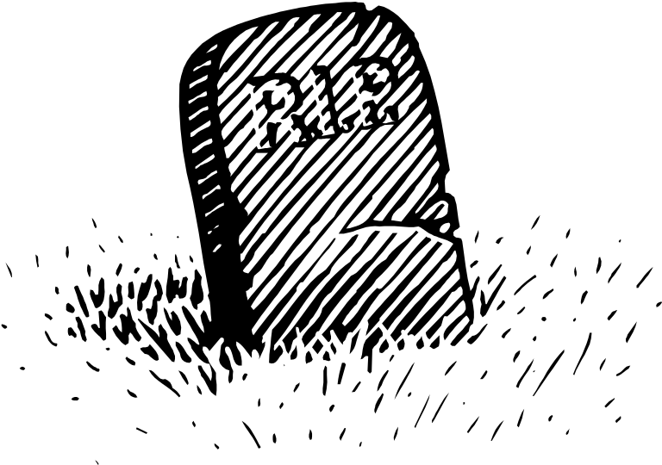
Use Rich Words
Remember words such as said, went, and put are DEAD. Use words that describe the action.

Slide 20

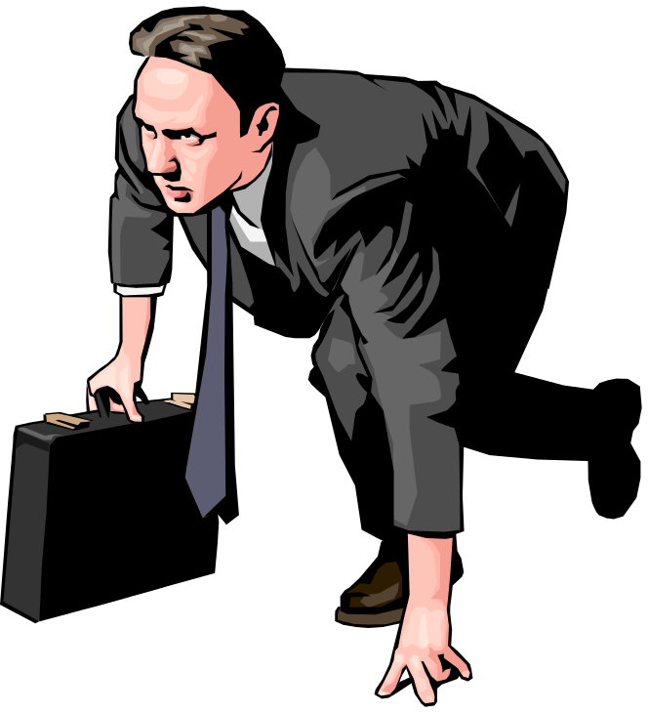

Went
NOT
My dad went to work.
BUT
My dad raced to work.

Slide 21

Said
NOT
Jane said she had a secret.
BUT
Jane whispered to Peter a wonderful secret.

Slide 22
Wow Words
Show your reader that you have a high-quality, first-class, superior, excellent, exceptional, outstanding, brilliant, extraordinary, incomparable vocabulary.

Slide 23
Don’t Use | Use These Instead:
good | acceptable, admirable, commendable, praiseworthy, virtuous, accomplished, skilled,
bad | Defective, erroneous, inadequate, substandard, corrupt, vile, distressing, severe, offensive, immoral
thing | material object, article, concept, entity, apparatus, device, detail, statement, items.
big | considerable, colossal, immense, sizable, vast, eminent, influential, paramount, prime, prominent
small | diminutive, immature, minute, slight, negligible, petty, trivial, limited.
important | far-reaching, grave, momentous, significant, substantial, prominent, notable
happy | content, joyous, jubilant, thrilled, advantageous, favorable, fortunate,
sad | sorrowful, cheerless, dismal, gloomy, melancholy, mournful, somber grievous
http://alon.hasharon.k12.il/new_ataralon/mikzoot/english/.%5Cdenise_text%5Cforcedownload.asp?fileToDownload=wowWords12class6.doc

Slide 24
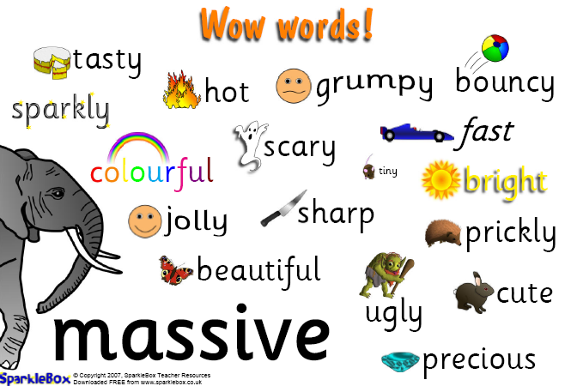
Wow Words
http://resources.sparklebox.me.uk/501-999/sb665.pdf

Slide 25

Show, Don’t Tell
The Show, Don’t Tell method of writing is when the writer is able to create a picture in the reader's mind, to get away from the repetition of such empty words like went, big, or said.

Slide 26

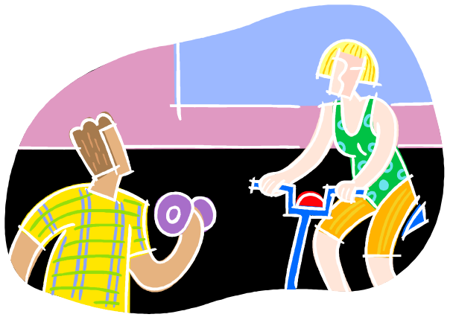
NOT
Susan exercised.
BUT
Sweat poured from Susan’s forehead as she continued to do one hundred sit-ups .

Slide 27
Conversation
The Five Rules for Writing Direct Quotations
Rule 1 | Rule 2 | Rule 3 | Rule 4 | Rule 5
Add quotation marks. | Separate source phrase from quote. | Capitalize the first word of the direct quotation. | Add end marks. | Add needed capitalization and punctuation.

Slide 28
Sentences
Vary your sentences.
  Are some of your sentences long and others short?
  Do you start the beginnings differently?
  Do some sentences start with a part of speech other than a noun or pronoun?

Slide 29
Figurative Language
Use a little figurative language to add interest to your story.
Simile
Metaphor
Alliteration
Onomatopoeia

Slide 30
Simile
comparison between two unlike things that have something in common using like or as
Examples
It's been a hard day's night and I've been working like a dog. - The Beatles
My heart is like an open highway. - Jon Bon Jovi
like two peas in a pod
like Christmas in summer
as hungry as a bear
as nutty as a fruitcake
as quick as lightning

Slide 31
Metaphor
Metaphor– comparison between two unlike things that have something in common without using like or as
Examples
Patty was a raging tiger when she lost her lunch money.
During the night the forest was a dark, frightening battlefield.

Slide 32
Alliteration
repetition of usually initial consonant sounds in two or more neighboring words or syllables
Examples
  down in the dumps
  do or die
  right as rain
  sink or swim
  pay the price
  back to the basics
  green as grass
  live the life

Slide 33
Onomatopoeia
the imitation of natural sounds in word form. These words help us form mental pictures about the things, people, or places that are described
Examples
  buzz
  hiss
  roar
  woof
  bang
  pop
  hiss
  sizzle

Slide 34
Plot Structure
http://www.learner.org/interactives/story/cinderella.html
a plot, including setting and characters
a climax (This is when the plot is solved.)
an ending

Slide 35
United Streaming
Parts of a Story: Huck and Jim [05:34]
http://player.discoveryeducation.com/index.cfm?guidAssetId=20D49155-2509-447F-8C47-69C9B3D2128A&blnFromSearch=1&productcode=US

Slide 36
Beginning
In the beginning of your story, you should introduce your characters.
The reader should also know about the world your characters live in (the setting) and the something about each of the characters in your story.
The beginning of your story is also the place where your plot (the problem) is first introduced.

Slide 37
Middle
Your story needs to build to something exciting, the climax. Write about a simple conflict, a task that must be completed, a question that must be answered, or a barrier that must be overcome.
Climax
Rising Action
Resolution
Beginning

Slide 38
Middle
Include
  Actions
  Dialogue
  Sensory Details
  Thoughts and Feelings
  Suspense (Remember to build to a climax.)

Slide 39
The End
This is the big finish. The end should reveal how you overcame your problem. All conflicts are resolved and everything goes back to normal.

